Slide 1

Bank management system!
Object oriented programming project
Presented by :
En20cs301322 Priyanshi jain
En20cs301338 Rashmeet Chugga
En20cs301347 Ridhima Namdev
submit to:
Prof.arpit deo sir

Slide 2
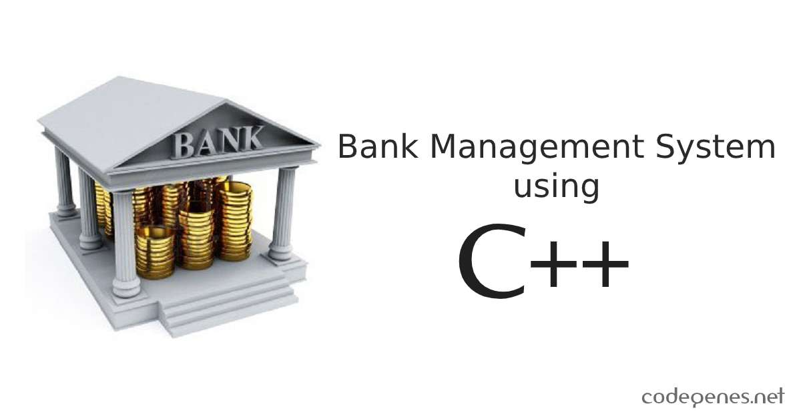
Aim of the Project :
To develop a bank management system using C++ for solving financial applications of a customer in banking environment in order to nurture the needs of an end banking user by providing various ways to perform banking tasks.

Slide 3
Problem Description :
Bank Management System is based on a concept of recording customer’s account details. Here the user can perform all the tasks like creating an account, deposit amount, withdraw amount, check balance, view all account holders detail, close an account and modify an account. There’s no login system for this project. All the main features for banking system are set in this project. This project uses classes and file handling features of C++.

Slide 4
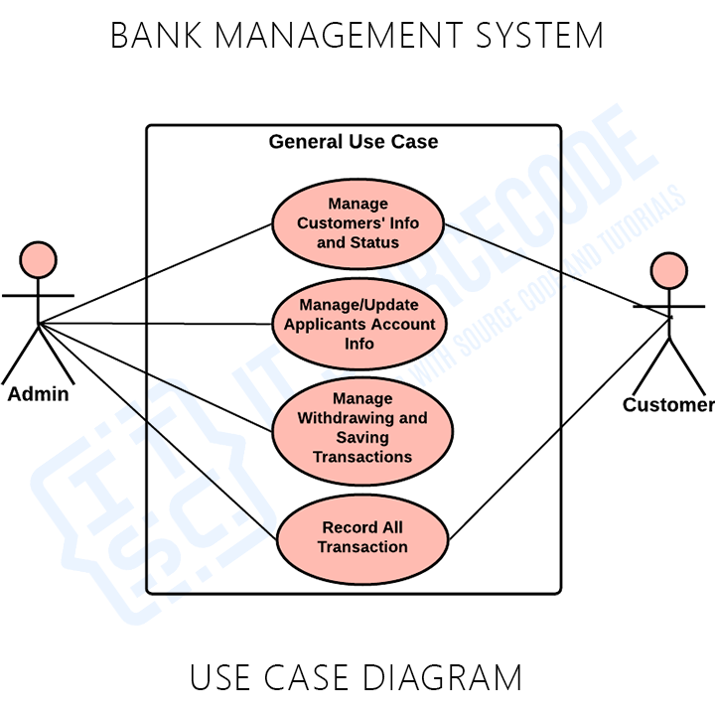

Slide 5
Modules | Description
Get account | Opens a new account for the user by accepting input of name, minimum balance and type of account.
Show record | This shows all the details of the customer like name, account number, type of account, total balance
Deposit Amount | Provides option to deposit amount to the given account
Withdraw | Provides option to withdraw amount from the given account
Balance enquiry | Display the list if customer's account details. Compressing of name, address, balance amount.
Return account | Returns the specific customer account number
Return amount | Returns the specific customer amount deposited in the account

Slide 6
Structure information
S no. | Variable names | Description | Data type
1 | cust_name | Applicant name | char
2 | ac_type | Bank account type | char
3 | amount | Applicant balance | Int
4 | ac_number | Applicant account number | int

Slide 7
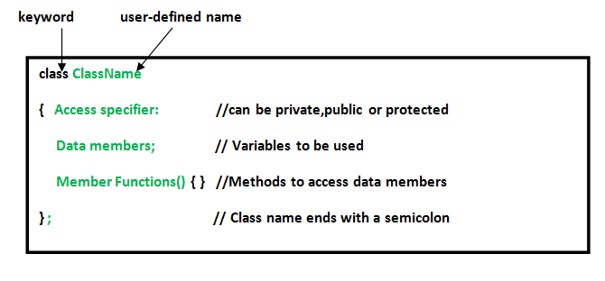
Class and object…
Class in C++ is a user-defined type or data structure that has data and functions (also called member variables and member functions) as its members whose access is governed by the three access specifiers private, protected or public. data members and member functions defines the properties and behavior of the objects in a Class.
An Object is an instance of a Class. When a class is defined, no memory is allocated but when it is instantiated (i.e. an object is created) memory is allocated
Class is a blueprint for creating objects.

Slide 8
Header files…
Header files contain the set of predefined standard library functions. Your request to use a header file in your program by including it with the C preprocessing directive “#include”. All the header file have a ‘.h’ an extension.
stdio.h --> standard input output library
iostream. --> provides basic input and output services for C++ programs

Slide 9
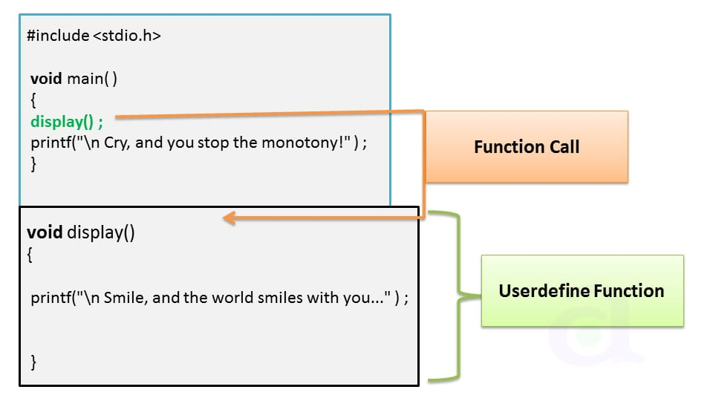
Function calling…
A function call is a request made by a program or script that performs a predetermined function. It is only called by its name in the main() function of a program. We can pass the parameters to a function calling in the main() function.
Two types of function calling
Call by value
Call by reference

Slide 10
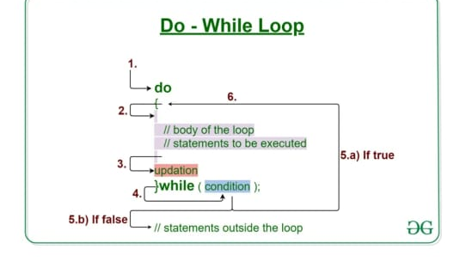
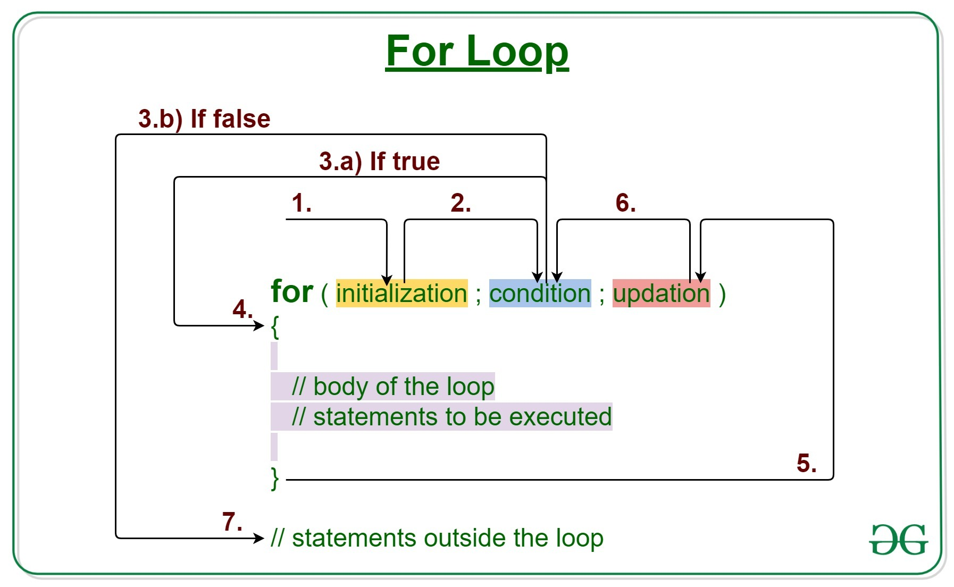
Do while loop and for loop…
do while loop come into use when we need to repeatedly execute a block of statements. Like while the do-while loop execution is also terminated on the basis of a test condition. In do-while loop the loop body will execute at least once irrespective of test condition.
A "For" Loop is used to repeat a specific block of code a known number of times. For example, if we want to check the grade of every student in the class, we loop from 1 to the number of students in the class.

Slide 11
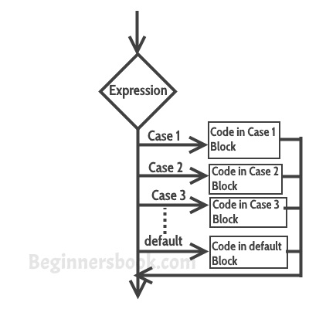
Switch case…
The switch statement is a multiway branch statement. It provides an easy way to dispatch execution to different parts of code based on the value of the expression. Switch is a control statement that allows a value to change control of execution.
It allows best optimized implementation for faster code execution than the “if else if “ statement

Slide 12
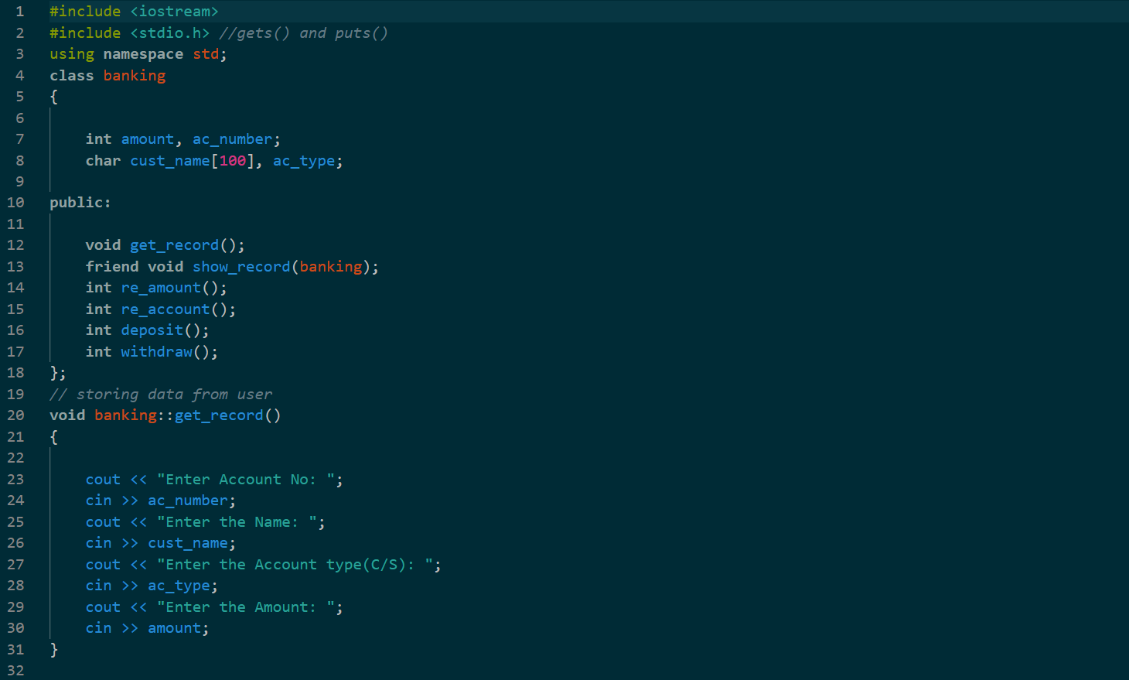
Source Code…!!!

Slide 13
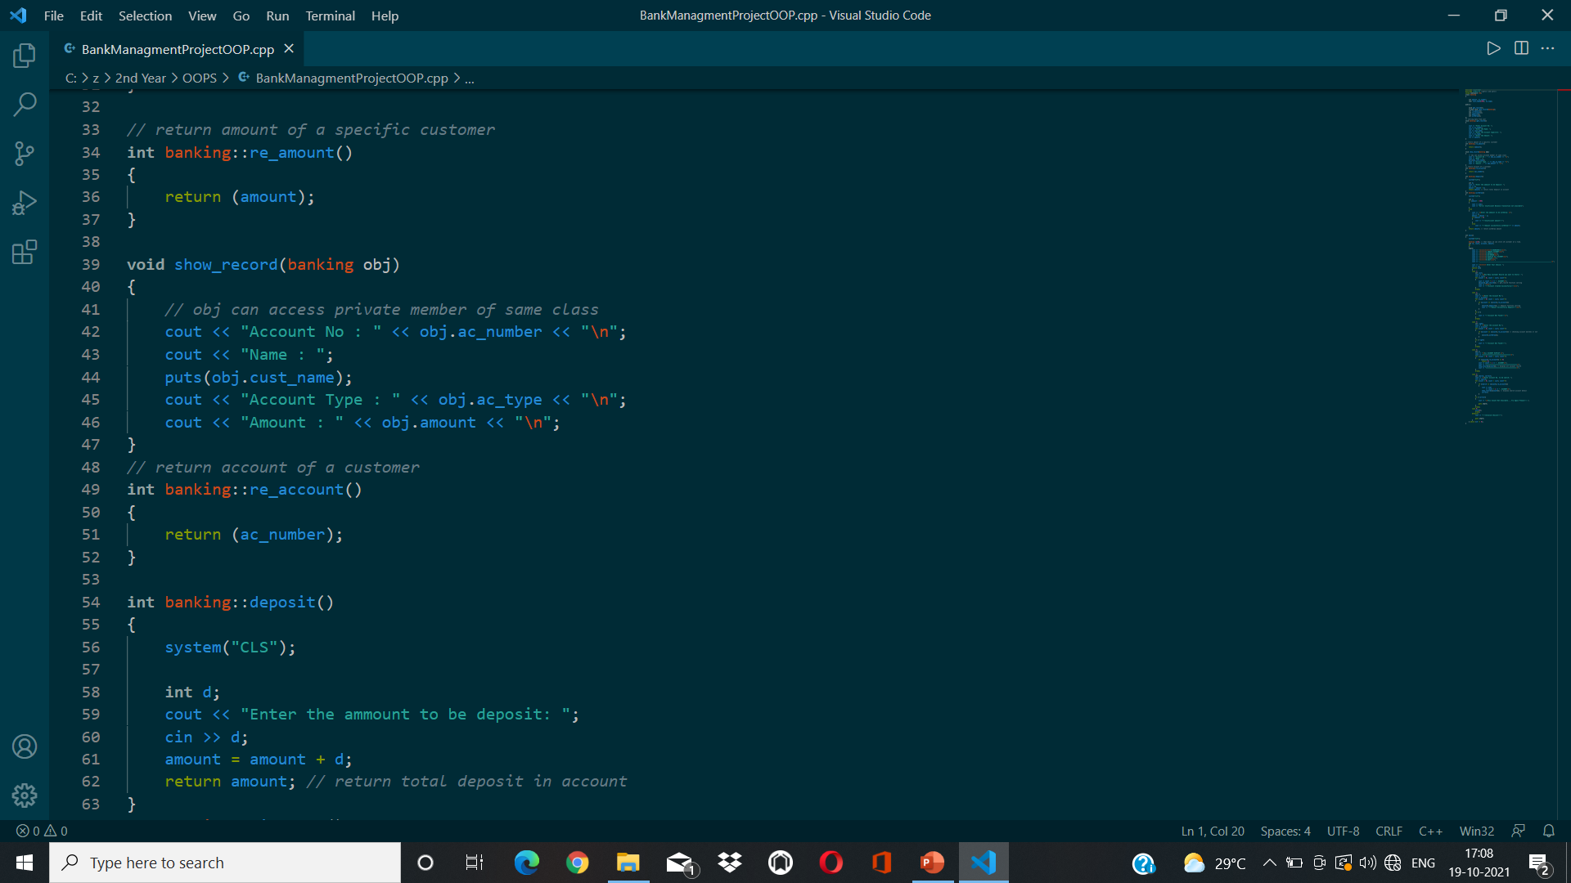

Slide 14
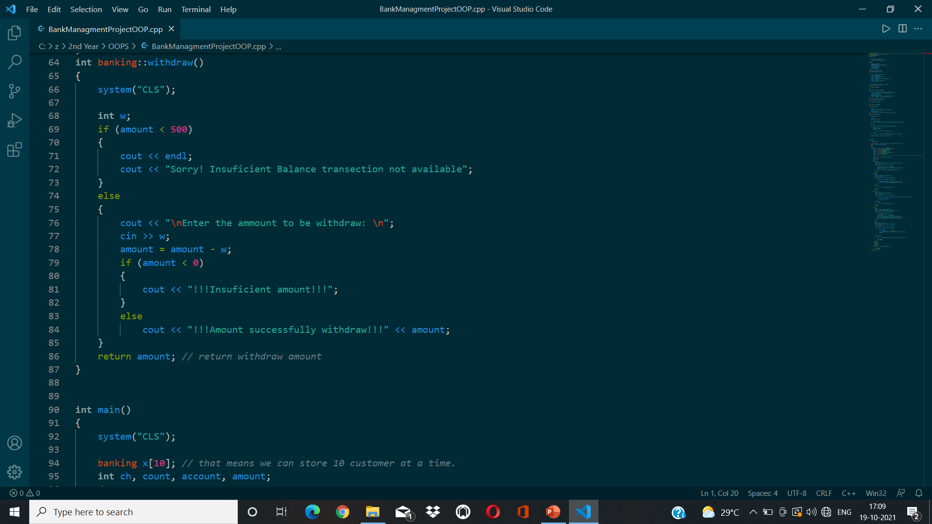

Slide 15
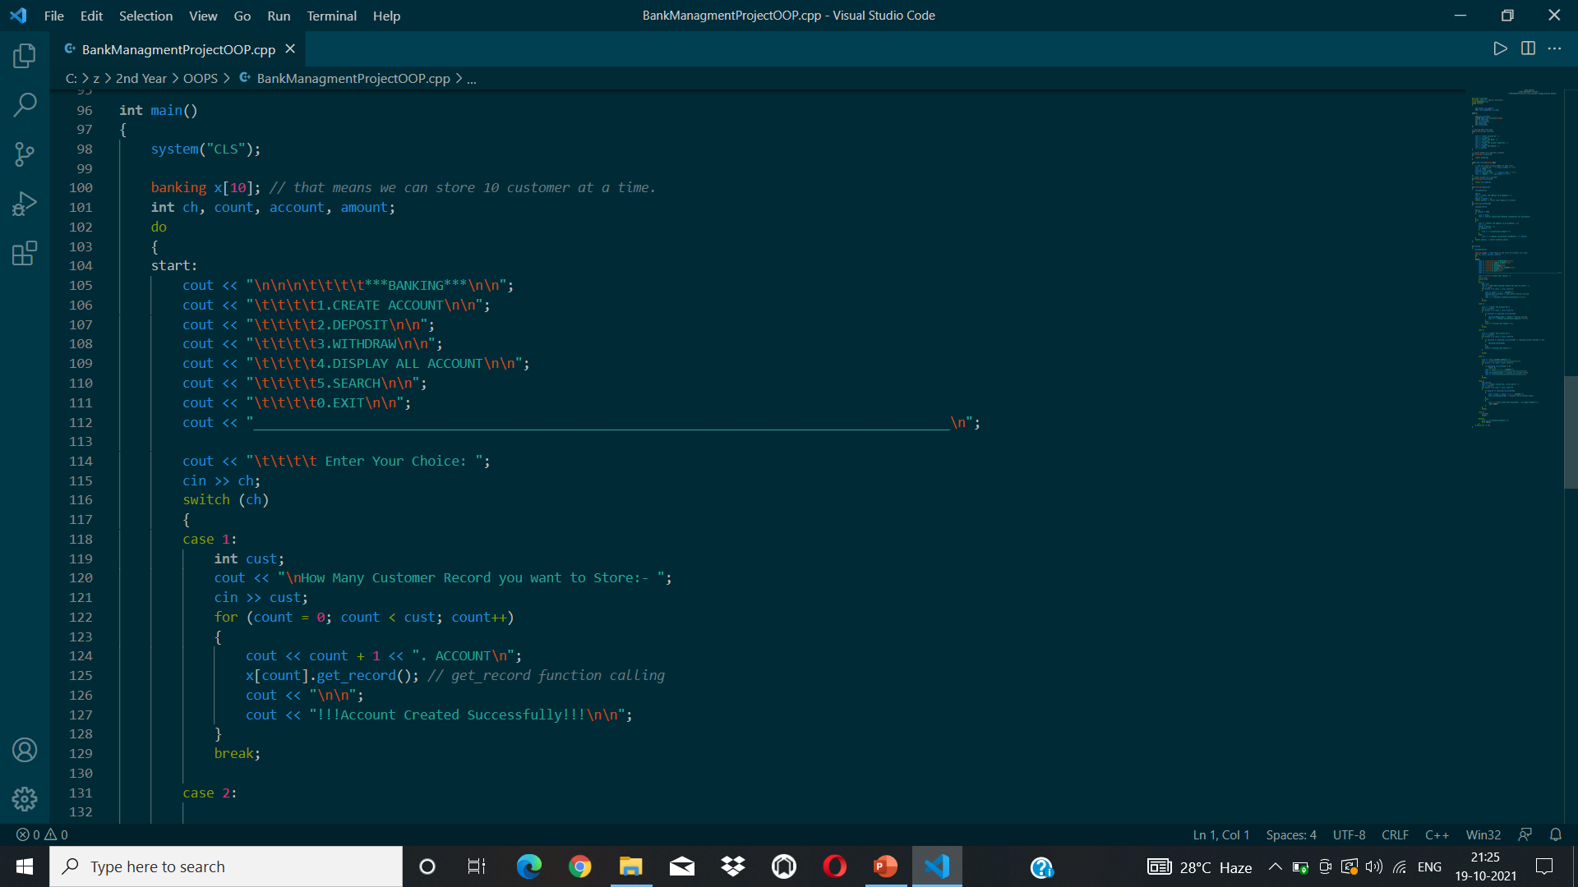

Slide 16
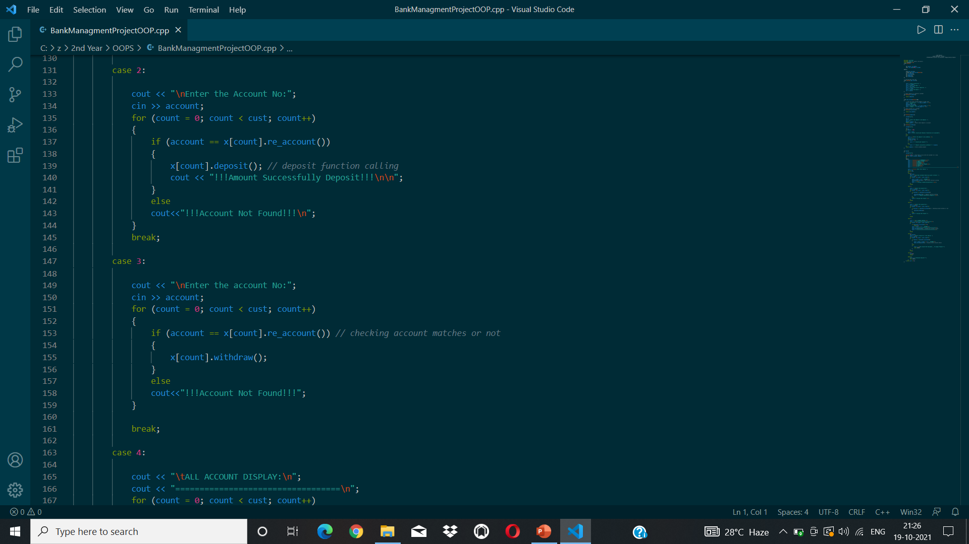

Slide 17
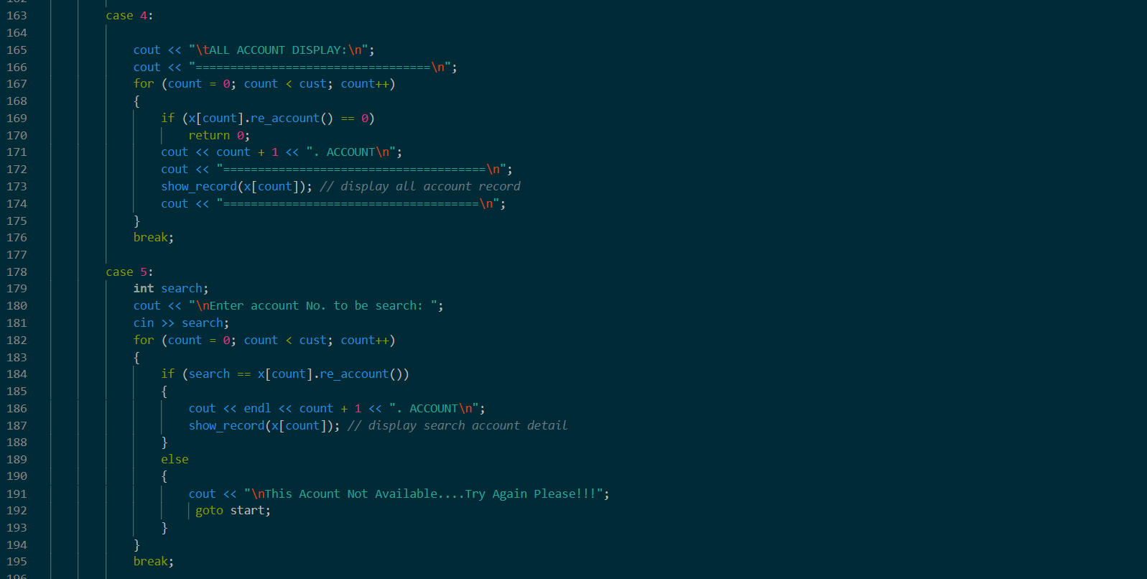
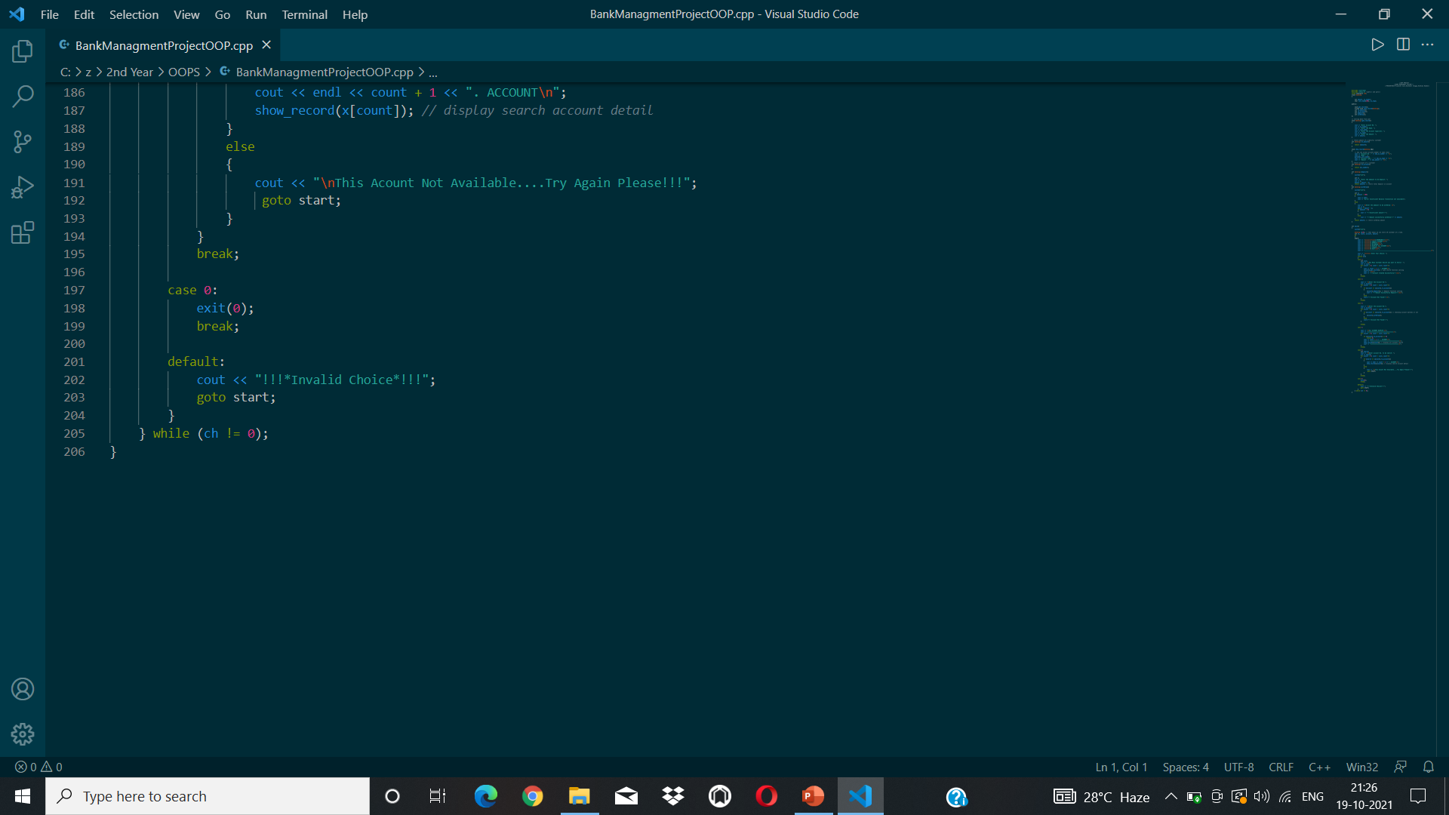

Slide 18

Program Strength :
User Friendly
Reduced Manpower
Accurate Results
Faster and Better Performance

Slide 19

Drawbacks…!!
The program is unable to save the full name(with surname).
It can accept the same account number of different users.
We won’t be able to modify the user information.

Slide 20

Conclusion..!!!
As a conclusion we can say that it’s a user friendly basesd on C++ language and a basic program which shows the basic information that we store in the bank account(like , name our account number, amount we have deposited in the bank, what kind of account we are consuming saving or current,) it gives a idea to the user about the structure or what are some details that we store in the bank account.

Slide 21
Thank you…!!

